Slide 1
Symbolism
English 9

Slide 3
A simple thing… Can Mean a big IDea
a brick wall, a locked gate inability to reach a goal
autumn leaves getting older, passage of time
storms, dark clouds troubles, difficulties, hardships
darkness, nighttime fear, the unknown, death
butterflies change, rebirth

Slide 4
How Does Symbolism Compare to Metaphor?
Metaphor:
a comparison between two things without using the words “like” or “as”
often comparing an abstract idea to a concrete object.
Example: To her, his love was a blooming, red rose.

Slide 5
More about Metaphor
Metaphor is related to symbolism because metaphor uses symbols.
Metaphor also helps you better understand a character (person), an event, or an emotion.
Example: The woman’s depression was a dark cloud over her head that followed her through each day.

Slide 6
Now On to Symbolism…
In comparison, symbolism illustrates the big ideas under the surface of a story.
The use of symbolism helps the reader understand abstract and complex concepts that all people can relate to or may experience in life, such as: death, rebirth, change, struggle, triumph, growth, grief, fear, obstacles, peace…

Slide 7
Example: As the final gunshots faded, and the battlefield fell silent, a single white dove appeared.
In the above example, the single white dove is a symbol of the end of war/peace, or the souls of the fallen soldiers…
Peace = doves are white & pure, which might signal purity entering the world after violence, darkness & bloodshed; doves are also peaceful creatures.
Souls… = doves are free, the soldiers are free from war & violence at last

Slide 8
Let’s Do Some Practice! If you consider each of the images On your Handout as symbols, what big ideas or concepts could they represent? Write down THREE IDEAS (words/phrases) for each.

Slide 9
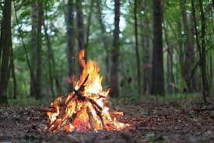
- light
- warmth
- togetherness
- control
- burning passion

Slide 10
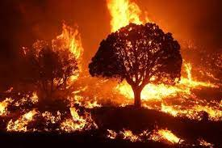
- death
- destruction
- distribution (something that spreads)
- anger/rage
- panic
- lack of control

Slide 11
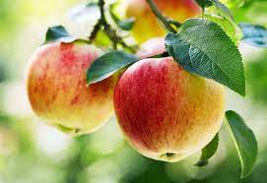
- health
- nutrition
- growth
- attachment
- temptation
- something
forbidden

Slide 12
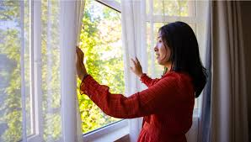
- new beginning
- new outlook
- another view/perspective
- open mind
- refresh
- sense of calm
- seeing things clearly

Slide 13
- stress
- confusion
- distraction
- research
- information
- entertainment
- communication

Slide 14
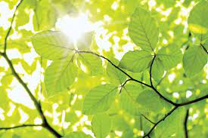
- wait (time)
- life (new life)
- vibrancy
- youth
- beginnings
- nature
- health of the natural world

